Slide 1
Minimum Spanning Trees
2704
867
BOS
849
PVD
ORD
740
187
144
1846
621
JFK
802
184
1258
SFO
1391
BWI
337
1464
1090
LAX
1235
DFW
946
1121
MIA
2342
Minimum Spanning Trees
Notes:
Minimum Spanning Tree

Slide 2
Minimum Spanning Trees (§ 12.7)
Spanning subgraph
  Subgraph of a graph G containing all the vertices of G
Spanning tree
  Spanning subgraph that is itself a (free) tree
Minimum spanning tree (MST)
  Spanning tree of a weighted graph with minimum total edge weight
Applications
  Communications networks
  Transportation networks
ORD
10
1
PIT
DEN
6
7
9
3
DCA
4
STL
8
5
2
DFW
ATL
Minimum Spanning Trees

Slide 3
Cycle Property
f
8
Cycle Property:
  Let T be a minimum spanning tree of a weighted graph G
  Let e be an edge of G that is not in T and C let be the cycle formed by e with T
  For every edge f of C, weight(f) ≤ weight(e)
  Proof:
  By contradiction
  If weight(f) > weight(e) we can get a spanning tree of smaller weight by replacing e with f
4
C
9
2
6
3
e
8
7
7
Replacing f with e yields
a better spanning tree
f
8
4
C
9
2
6
3
e
8
7
7
Minimum Spanning Trees

Slide 4
Partition Property
U
V
f
7
Partition Property:
  Consider a partition of the vertices of G into subsets U and V
  Let e be an edge of minimum weight across the partition
  There is a minimum spanning tree of G containing edge e
  Proof:
  Let T be an MST of G
  If T does not contain e, consider the cycle C formed by e with T and let f be an edge of C across the partition
  By the cycle property,
  weight(f) ≤ weight(e)
  Thus, weight(f) = weight(e)
  We obtain another MST by replacing f with e
4
9
2
5
8
8
e
3
7
Replacing f with e yields
another MST
U
V
f
7
4
9
2
5
8
8
e
3
7
Minimum Spanning Trees

Slide 5
Kruskal’s Algorithm (§ 12.7.1)
A priority queue stores the edges outside the cloud
  Key: weight
  Element: edge
At the end of the algorithm
  We are left with one cloud that encompasses the MST
  A tree T which is our MST
Algorithm KruskalMST(G)
for each vertex V in G do
define a Cloud(v) of ← {v}
let Q be a priority queue.
Insert all edges into Q using their weights as the key
T ← ∅
while T has fewer than n-1 edges do edge e = T.removeMin()
Let u, v be the endpoints of e
if Cloud(v) ≠ Cloud(u) then
Add edge e to T
Merge Cloud(v) and Cloud(u)
return T
Minimum Spanning Trees

Slide 6
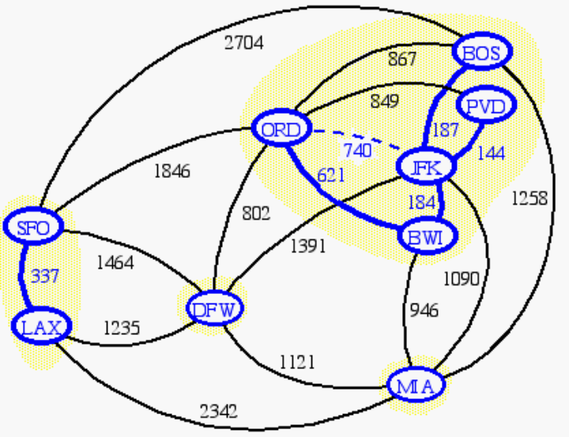
Data Structure for Kruskal Algortihm (§ 10.6.2)
The algorithm maintains a forest of trees
An edge is accepted it if connects distinct trees
We need a data structure that maintains a partition, i.e., a collection of disjoint sets, with the operations:
-find(u): return the set storing u
-union(u,v): replace the sets storing u and v with their union
Minimum Spanning Trees

Slide 7
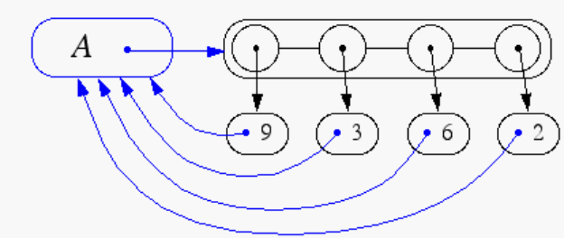
Representation of a Partition
Each set is stored in a sequence
Each element has a reference back to the set
  operation find(u) takes O(1) time, and returns the set of which u is a member.
  in operation union(u,v), we move the elements of the smaller set to the sequence of the larger set and update their references
  the time for operation union(u,v) is min(n_{u},n_{v}), where n_{u} and n_{v} are the sizes of the sets storing u and v
Whenever an element is processed, it goes into a set of size at least double, hence each element is processed at most log n times
Minimum Spanning Trees

Slide 8
Partition-Based Implementation
A partition-based version of Kruskal’s Algorithm performs cloud merges as unions and tests as finds.
Algorithm Kruskal(G):
Input: A weighted graph G.
Output: An MST T for G.
Let P be a partition of the vertices of G, where each vertex forms a separate set.
Let Q be a priority queue storing the edges of G, sorted by their weights
Let T be an initially-empty tree
while Q is not empty do
(u,v) ← Q.removeMinElement()
if P.find(u) != P.find(v) then
Add (u,v) to T
P.union(u,v)
return T
Running time: O((n+m)log n)
Minimum Spanning Trees

Slide 9
Kruskal Example
2704
867
BOS
849
PVD
ORD
187
740
144
1846
621
JFK
184
1258
802
SFO
BWI
1391
1464
337
1090
DFW
946
LAX
1235
1121
MIA
2342
Minimum Spanning Trees

Slide 10
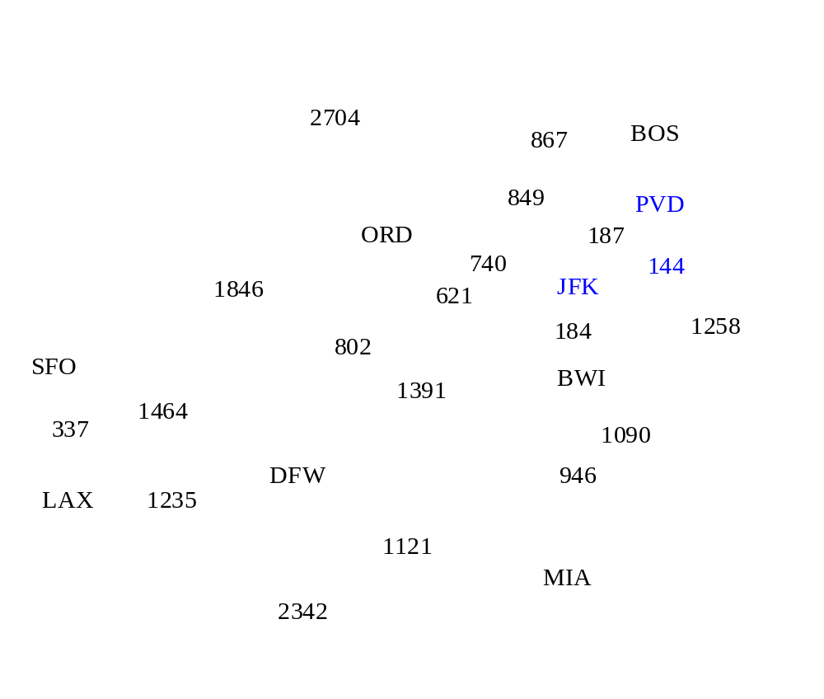
Example
Minimum Spanning Trees

Slide 11
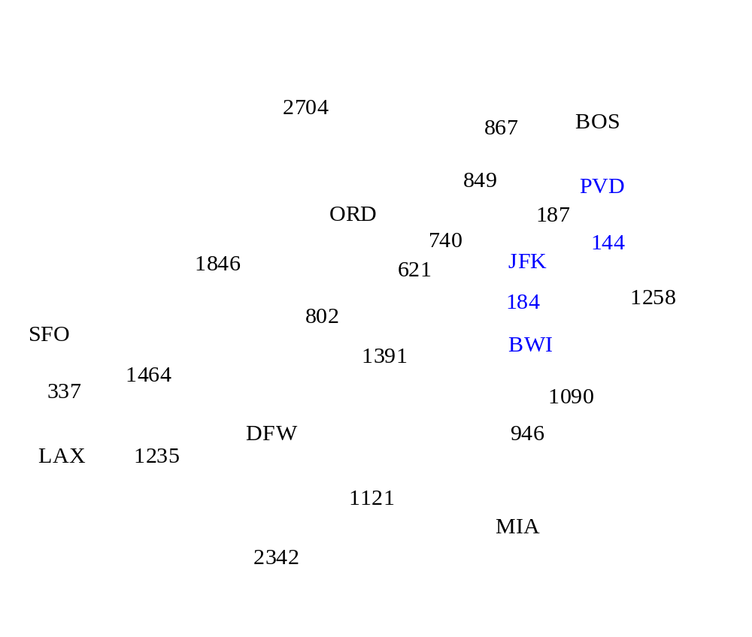
Example
Minimum Spanning Trees

Slide 12
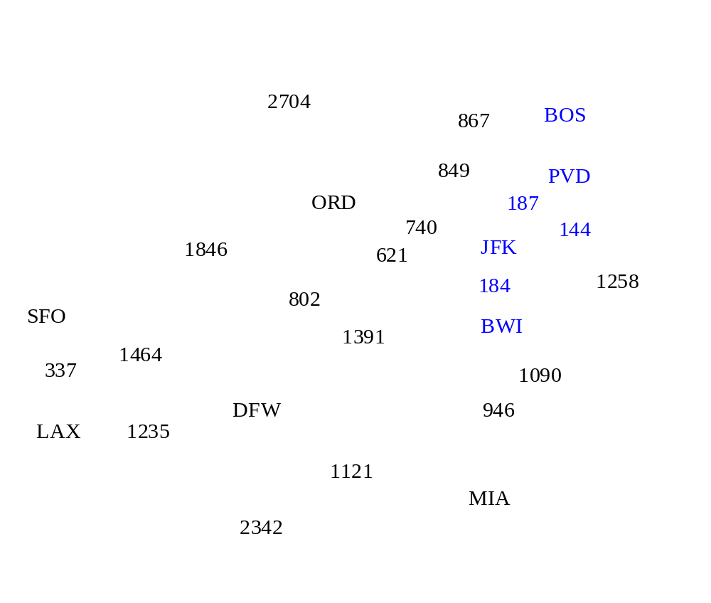
Example
Minimum Spanning Trees

Slide 13
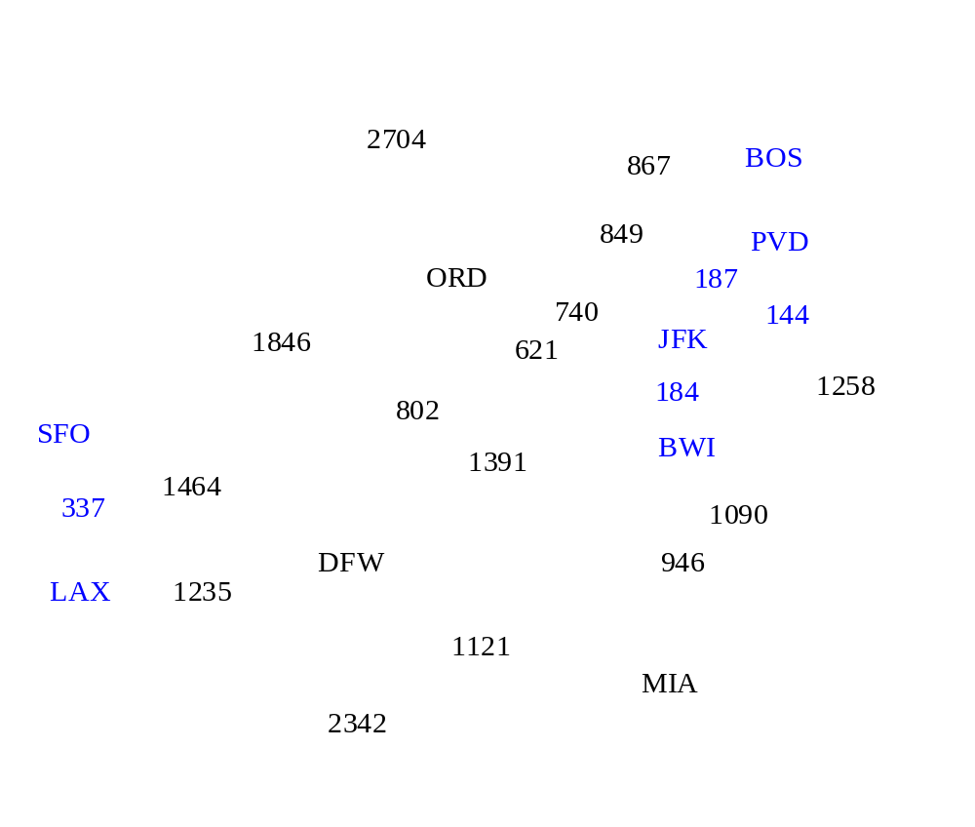
Example
Minimum Spanning Trees

Slide 14
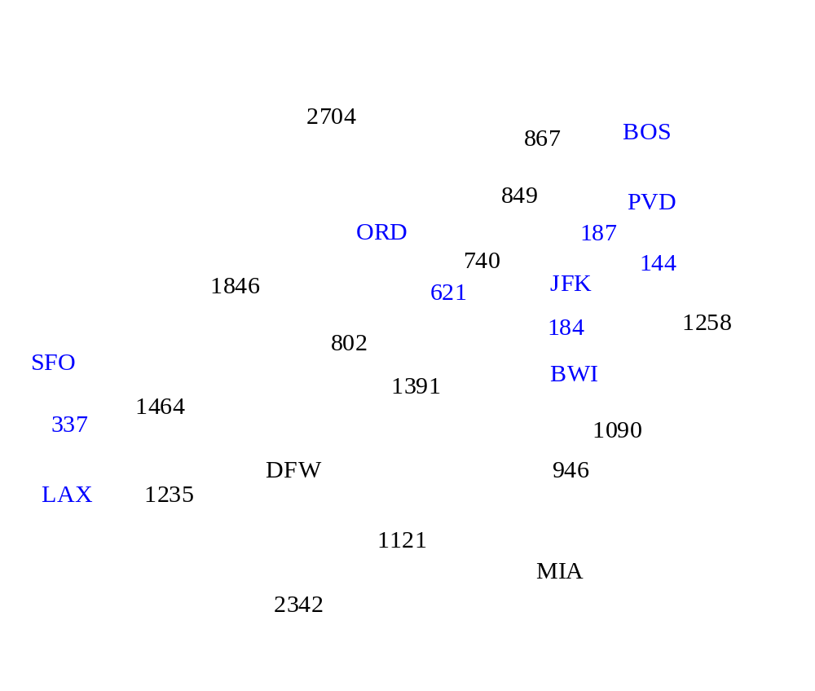
Example
Minimum Spanning Trees

Slide 15
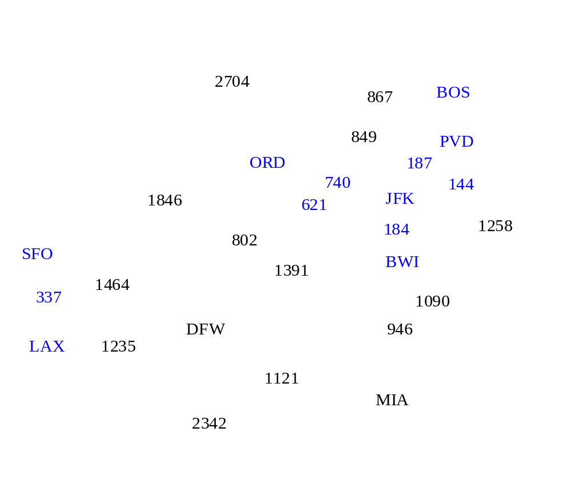
Example
Minimum Spanning Trees

Slide 16
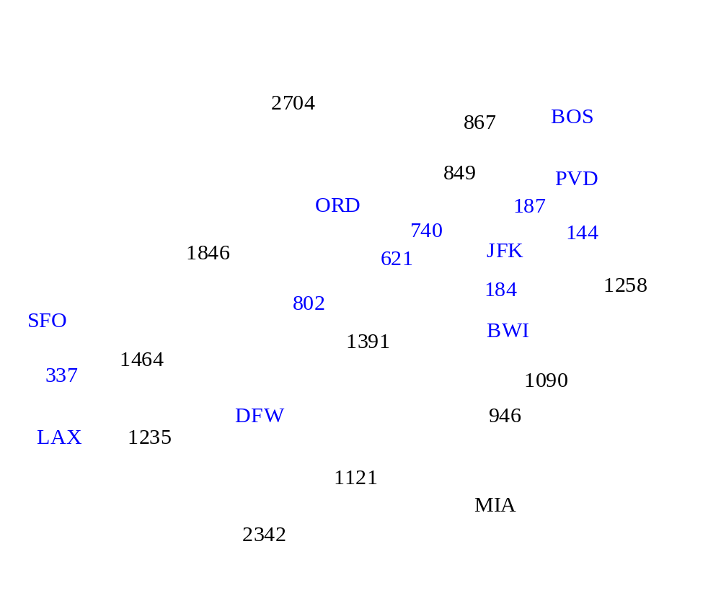
Example
Minimum Spanning Trees

Slide 17
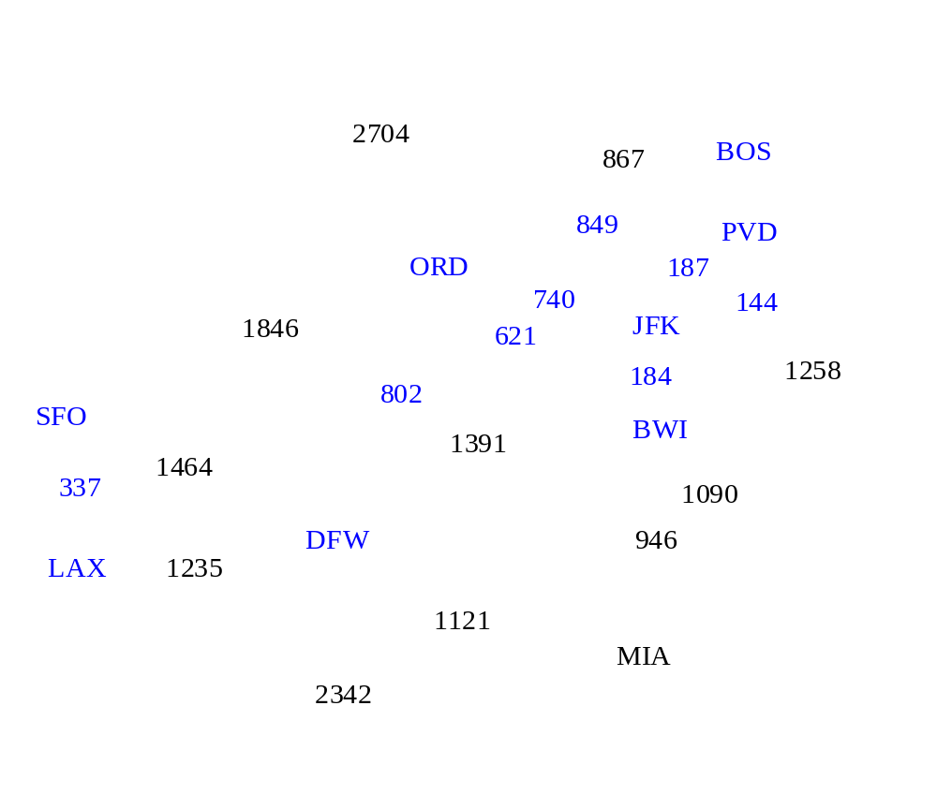
Example
Minimum Spanning Trees

Slide 18
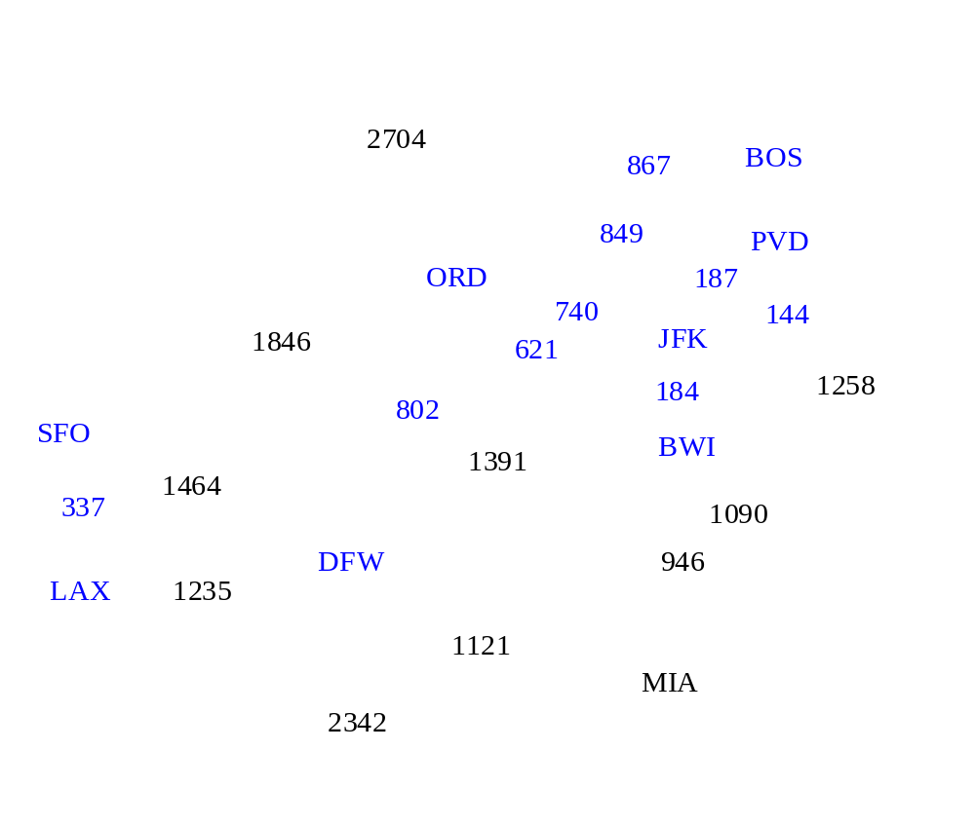
Example
Minimum Spanning Trees

Slide 19

Example
Minimum Spanning Trees

Slide 20
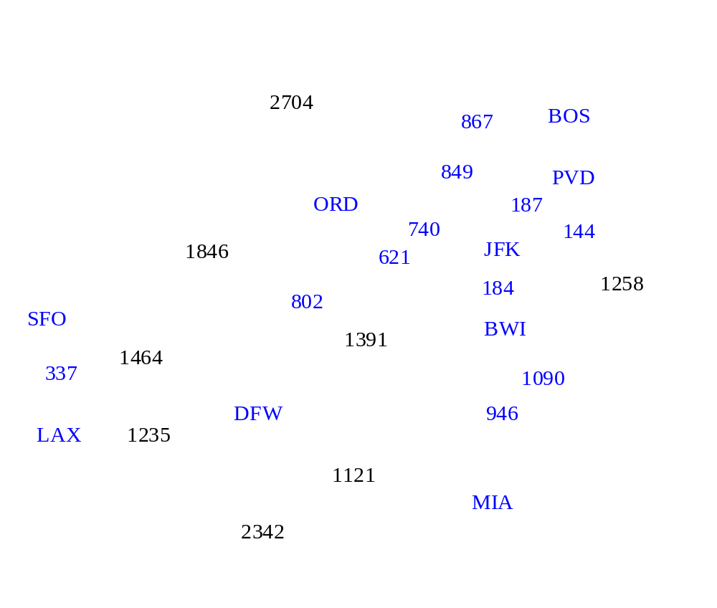
Example
Minimum Spanning Trees

Slide 21

Example
Minimum Spanning Trees

Slide 22
Example
2704
867
BOS
849
PVD
ORD
187
740
144
1846
621
JFK
184
1258
802
SFO
BWI
1391
1464
337
1090
DFW
946
LAX
1235
1121
MIA
2342
Minimum Spanning Trees

Slide 23
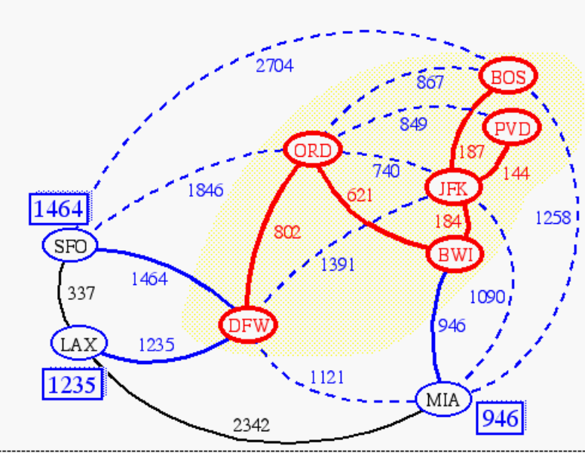
Prim-Jarnik’s Algorithm (§ 12.7.2)
Similar to Dijkstra’s algorithm (for a connected graph)
We pick an arbitrary vertex s and we grow the MST as a cloud of vertices, starting from s
We store with each vertex v a label d(v) = the smallest weight of an edge connecting v to a vertex in the cloud
At each step:
  We add to the cloud the vertex u outside the cloud with the smallest distance label
  We update the labels of the vertices adjacent to u
Minimum Spanning Trees

Slide 24
Example
∞
7
2
7
D
2
7
D
B
4
B
4
8
9
∞
5
9
∞
2
5
F
2
5
F
C
8
C
8
8
3
8
3
E
E
A
7
7
A
7
7
0
0
7
7
2
7
D
7
D
B
4
2
B
4
5
9
∞
9
4
2
5
F
5
5
C
2
F
8
C
8
8
3
3
E
8
A
7
E
0
7
A
7
7
0
Minimum Spanning Trees

Slide 25
Example (contd.)
7
2
7
D
B
4
5
9
4
2
5
F
C
8
8
3
E
A
7
3
7
0
7
D
2
B
4
5
9
4
2
5
F
C
8
8
3
E
A
7
3
0
Minimum Spanning Trees

Slide 26
Baruvka’s Algorithm (Ex. C-12.28)
Like Kruskal’s Algorithm, Baruvka’s algorithm grows many “clouds” at once.
Each iteration of the while-loop halves the number of connected compontents in T.
  The running time is O(m log n).
Algorithm BaruvkaMST(G)
T ← V {just the vertices of G}
while T has fewer than n-1 edges do
for each connected component C in T do
Let edge e be the smallest-weight edge from C to another component in T.
if e is not already in T then
Add edge e to T
return T
Minimum Spanning Trees

Slide 27
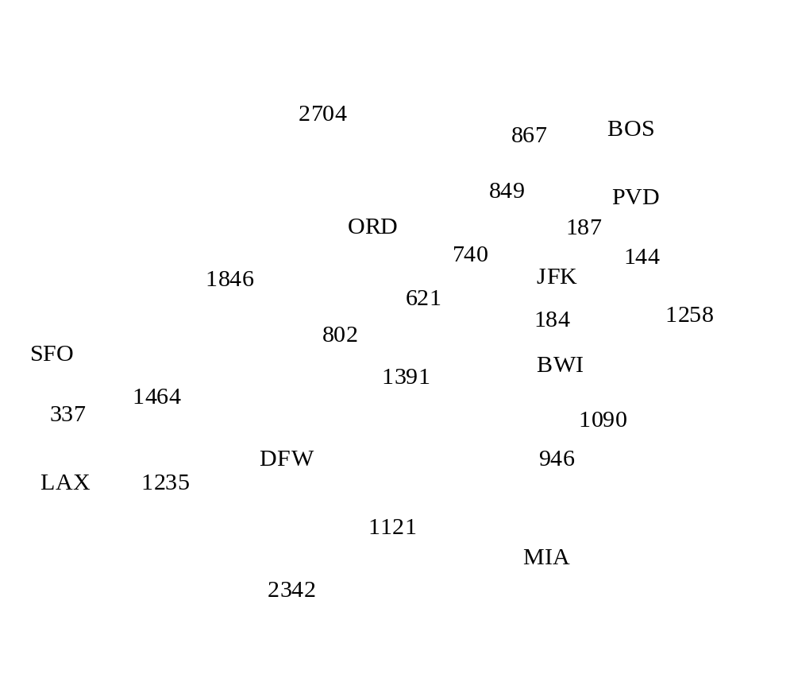
Baruvka Example
Minimum Spanning Trees

Slide 28
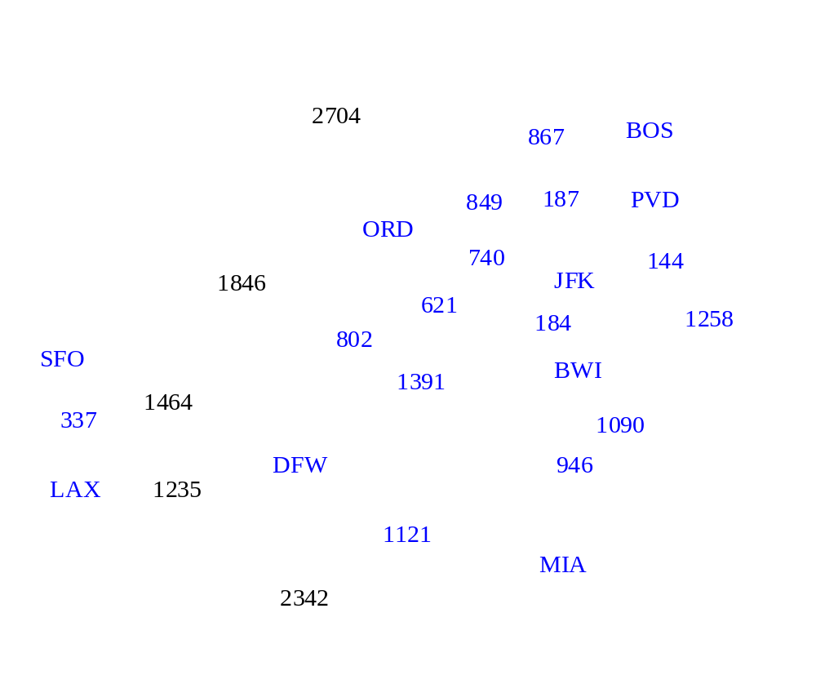
Example
Minimum Spanning Trees

Slide 29
Example
2704
867
BOS
849
187
PVD
ORD
740
144
1846
JFK
621
184
1258
802
SFO
BWI
1391
1464
337
1090
DFW
946
LAX
1235
1121
MIA
2342
Minimum Spanning Trees

